Slide 1

Data Driven Plant Care & Agriculture
Babandeep Singh
Yu-An Lin

Slide 2
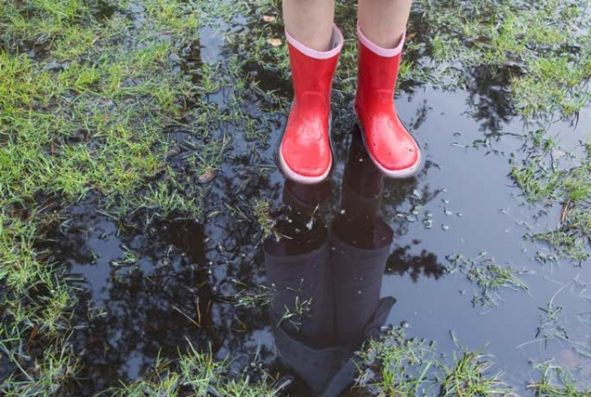
Why?
More than
50% of water
used for landscaping and Irrigation
is wasted due to
overwatering
Traditional
Irrigation Methods
don’t account for
changing environmental
conditions
Available solutions are expensive and difficult to scale

Slide 3
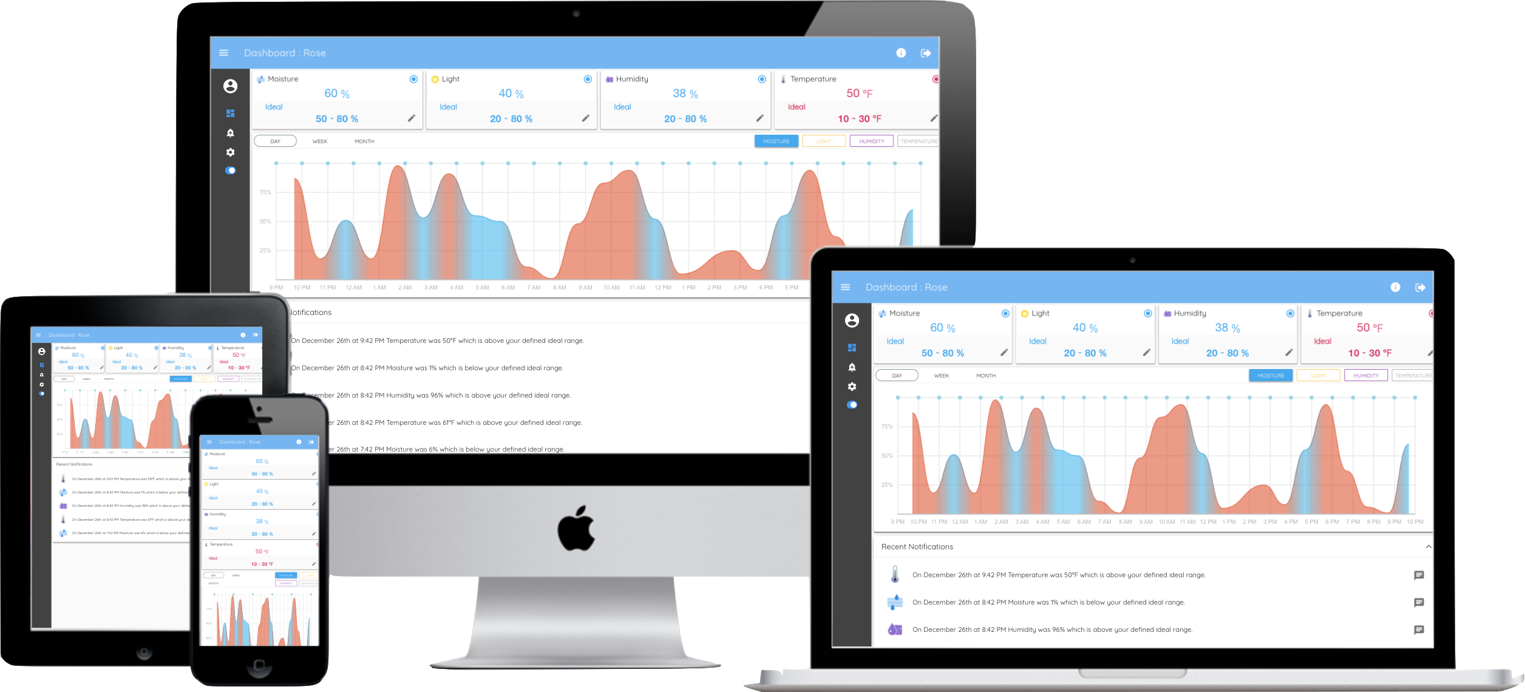



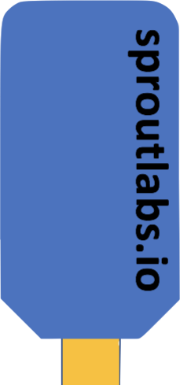
System Architecture

Slide 4
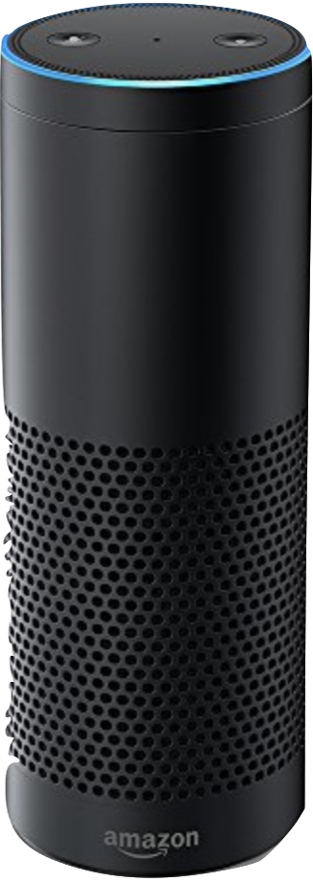



Ease of Information Access

Slide 5
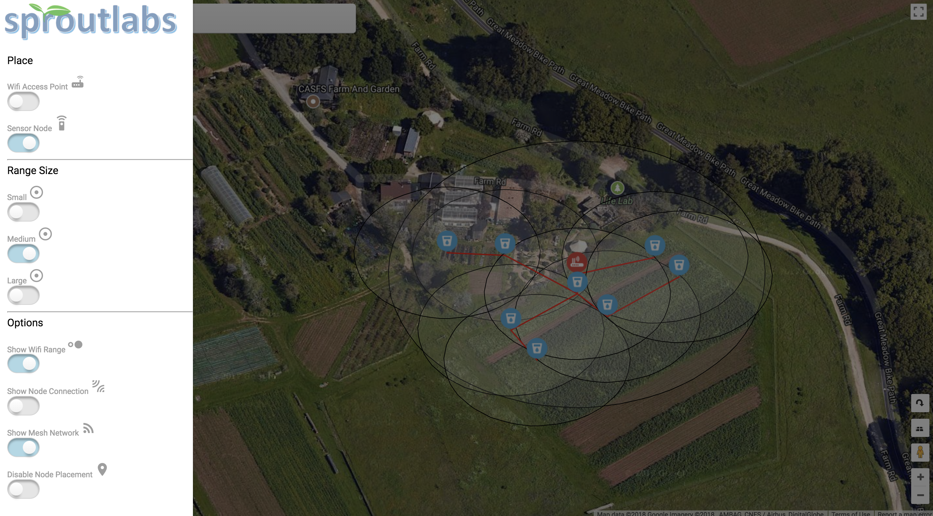
Making Scalability Possible

Slide 6
Questions?

